Slide 1


Identifying and Balancing Competing Definitions of Risk on Digital Game Development Projects
Marc Schmalz Boise State University marcschmalz@boisestate.edu
Daniel Rush Boise State University danrush@boisestate.edu
Amy J. Connolly James Madison University conno3aj@jmu.edu
Notes:
Hello. I’m Marc, and I’m here with my co-authors Dan and Amy to ask you for feedback on our research agenda. This paper represents our expected Next Step for that.

Slide 2

Agenda
Introduction to This Research Research in Progress
Contextual Nuance
Research Questions
Data Collection
Proposed Methods
AI Mess
Contributions
Feedback

Slide 3
Introduction to This Research in Progress
1999
Aug 2025
Dec 2025
Spring 2026
Future
Wallace Risk Instrument
Test pilot study
Here’s our Plan
Conduct Case Study
Contribute
Hey, let’s do a replication study, but in games
Different participants interpreted questions differently
Can you help critique?
Collect qualitative data about a game studio’s development projects
Notes:
This all started out thinking we’d take an established risk instrument, developed by Wallace in 1999, and test it in modern contexts, especially with Digital Games. When we did a pilot study, it turned out the old instrument really wasn’t valid for our set of three modern project team members. We wrote an AMCIS ERF about that.

Slide 4
Introduction to This Research in Progress
1999
Aug 2025
Dec 2025
Spring 2026
Future
Wallace Risk Instrument
Test pilot study
Here’s our Plan
Conduct Case Study
Contribute
Hey, let’s do a replication study, but in games
Different participants interpreted questions differently
Can you help critique?
Collect qualitative data about a game studio’s development projects
YOU ARE HERE
Notes:
We’re here to ask for feedback on our direction and our proposed case study, and for future directions for the whole research program.

Slide 5

Contextual Nuance in Digital Games
Hedonic Software
Cultural Texts
Producers not Managers
Creative Team Roles
Complex Success Criteria
Notes:
So, why digital games? Well, they tend to be overlooked in MIS even though they use many of the same tools, techniques, and processes. The users of complex games may be using fantastic versions of real-world applications, and then there are the internal back-end tools that may also parallel their MIS cousins. But the public side is fundamentally hedonic, not utilitarian, since they’re producing cultural texts, follow an entertainment model where they even call their project managers Producers, have more design roles than typical MIS projects, and have success criterial that extend beyond sch

Slide 6

Research Questions
How are risks defined in digital game development projects?
How are competing definitions of risk understood and balanced in digital game development projects?
To what extent does the definition of project success differ from the traditional project management standard definition on a digital game development project?

Slide 7
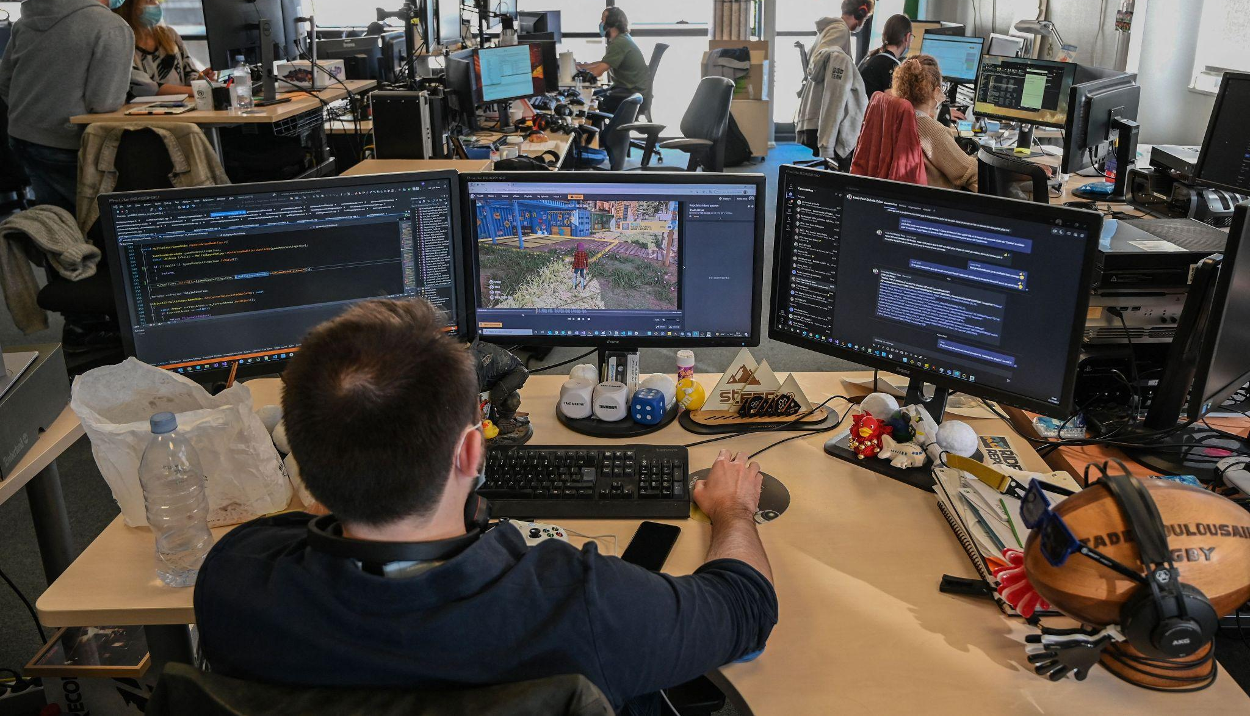
Proposed Methods
Case Study (small-to-medium digital game studio)
Review Public Data (news, analysis, filings)
Conduct Semi-structured Interviews (multiple roles)
Observe Development and Risk Management Processes
Collect Artifacts
Analyze Qualitatively

Slide 8
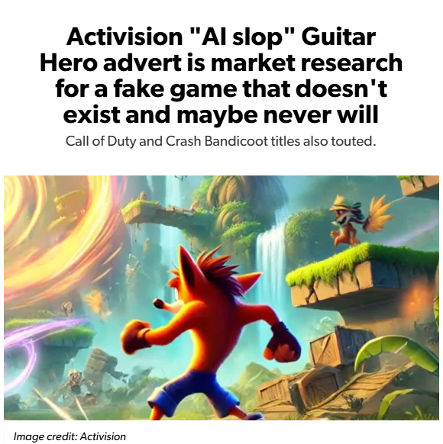
Then There’s the AI Mess
Generative AI Project Risk Impact
Legal Concerns
Customer / Creator / Management Differences
Slop
Uses vs Perceptions
Impacts on Sense of Ownership

Slide 9

Contributions
New Context
Diverse Stakeholders
New Theory
New Instruments
Notes:
With this overall research program, we’re hoping to add nuance to the body of project management research by looking at new contexts and involving additional stakeholders. We’re using qualitative methods at the start to collect rich data to help inform new theory.

Slide 10
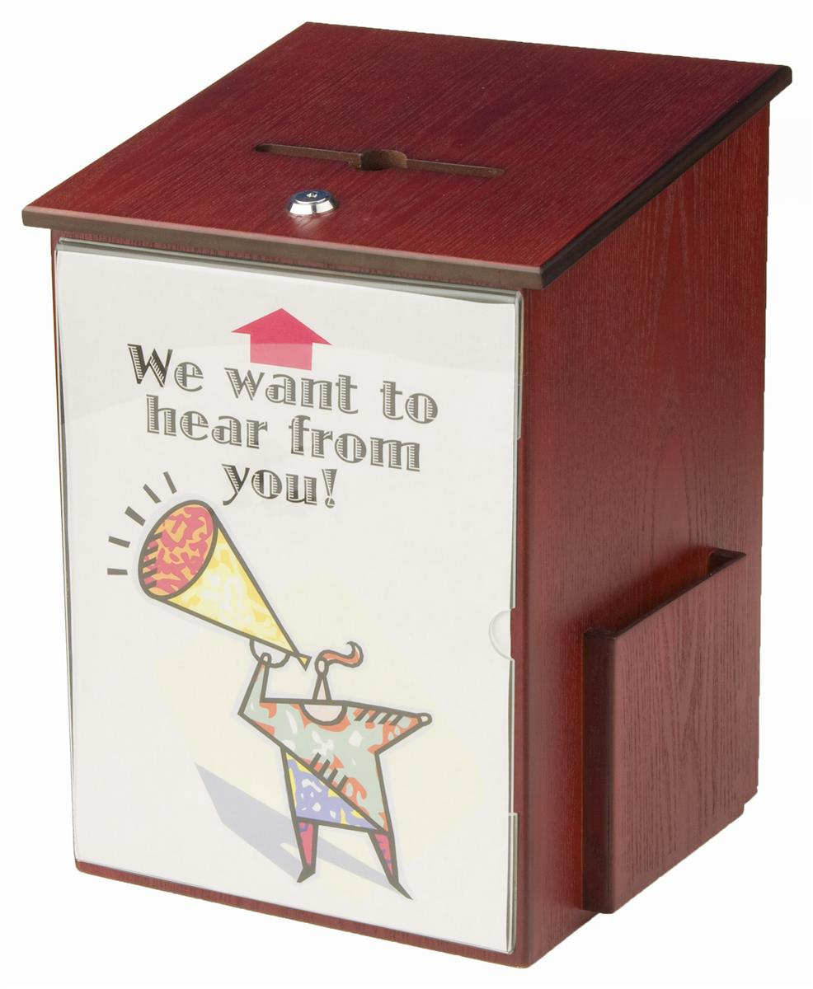
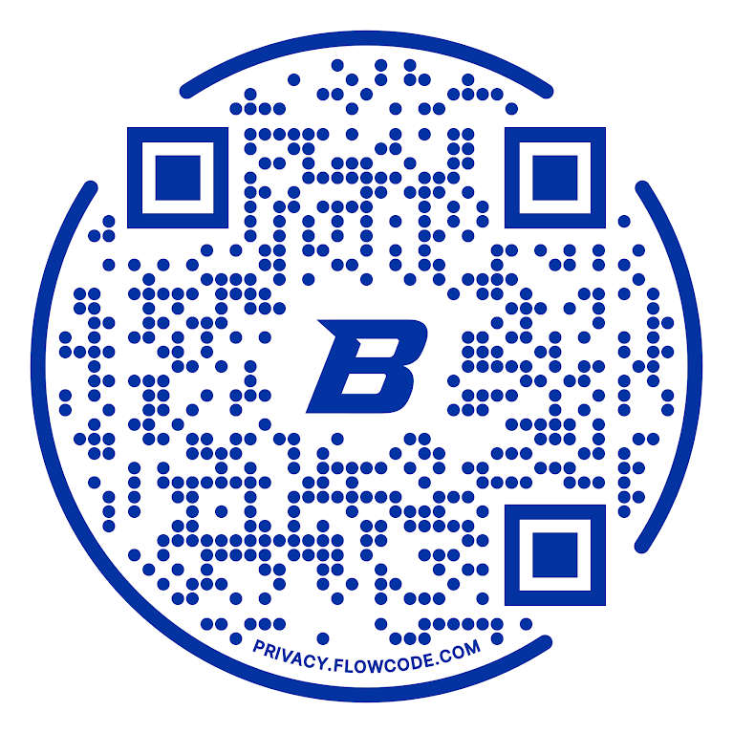
Feedback Please!
Important Literature
Data Gathering
Analysis
Related Contexts
Link to Interview Protocol
Notes:
We’d appreciate any feedback you might have.

Slide 11
Identifying and Balancing Competing Definitions of Risk on Digital Game Development Projects
Marc Schmalz Boise State University marcschmalz@boisestate.edu
Daniel Rush Boise State University danrush@boisestate.edu
Amy J. Connolly James Madison University conno3aj@jmu.edu
Notes:
Thanks!

